Slide 1
Simple MDEvent algorithms
Andrei T. Savici

Slide 2
"Simple"
Intensities and errors change
Number of MD events and coordinates stay the same
Box structure stays the same
Examples: detailed balance, absorption corrections, flipping ratio corrections, Debye-Waller, magnetic form factor
Change of intensity/error depends on coordinates, sample logs, maybe detector position

Slide 3
Algorithm structure
Mostly same as regular algorithms
init
exec
validateInputs
Worker function

Slide 4
Input validation
Check if the workspace dimensions make sense
Check if you have the required logs
Cache information that would be expensive to continuously look up for every event
Incident energy
Temperature

Slide 5
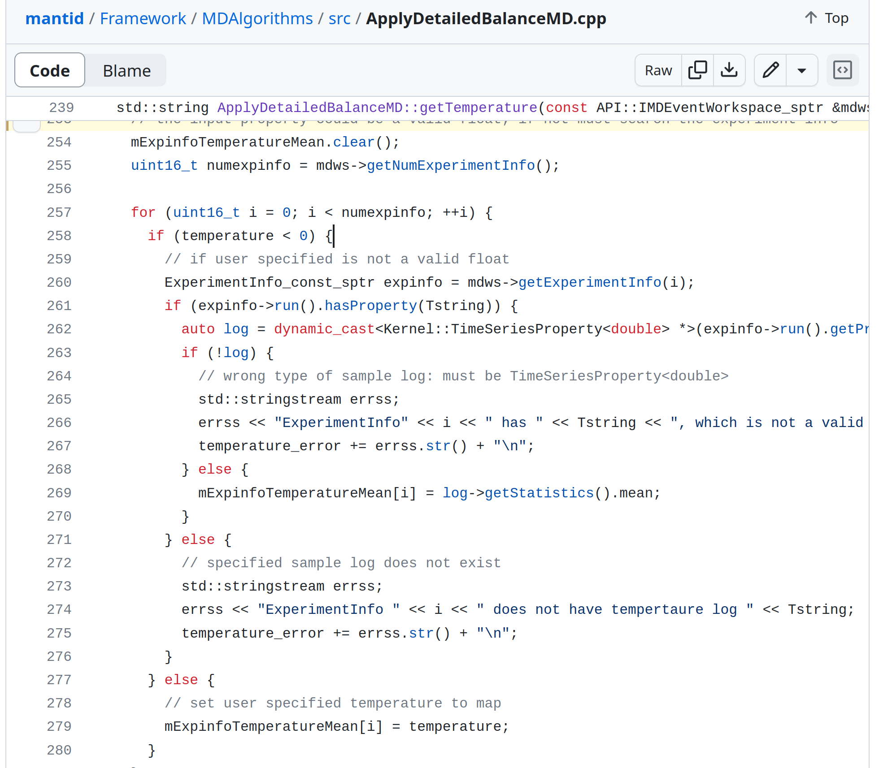
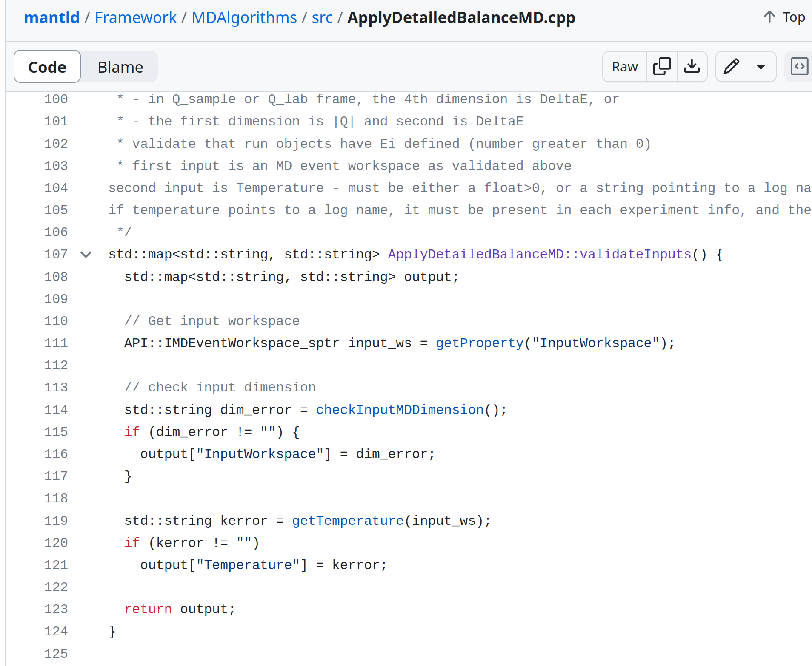
Input validation

Slide 6
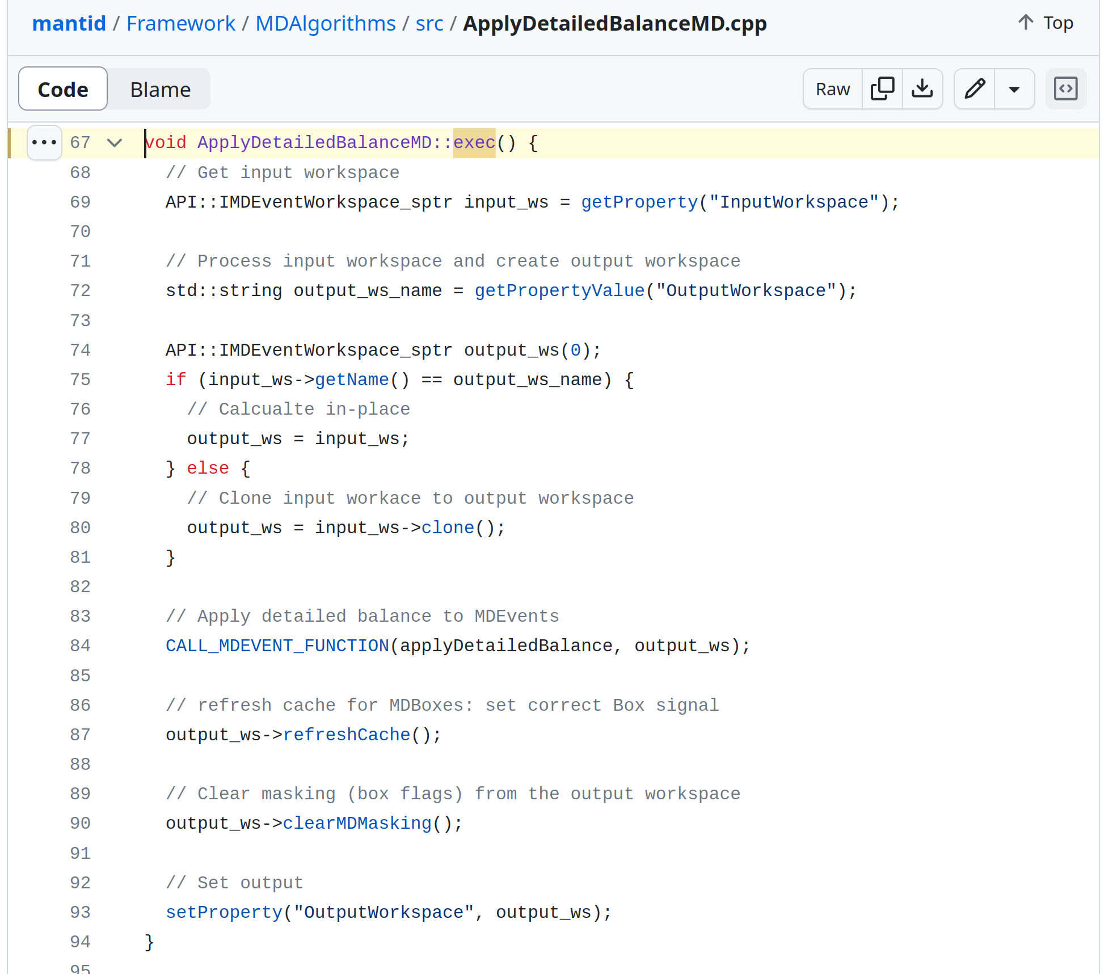
The exec function

Slide 7
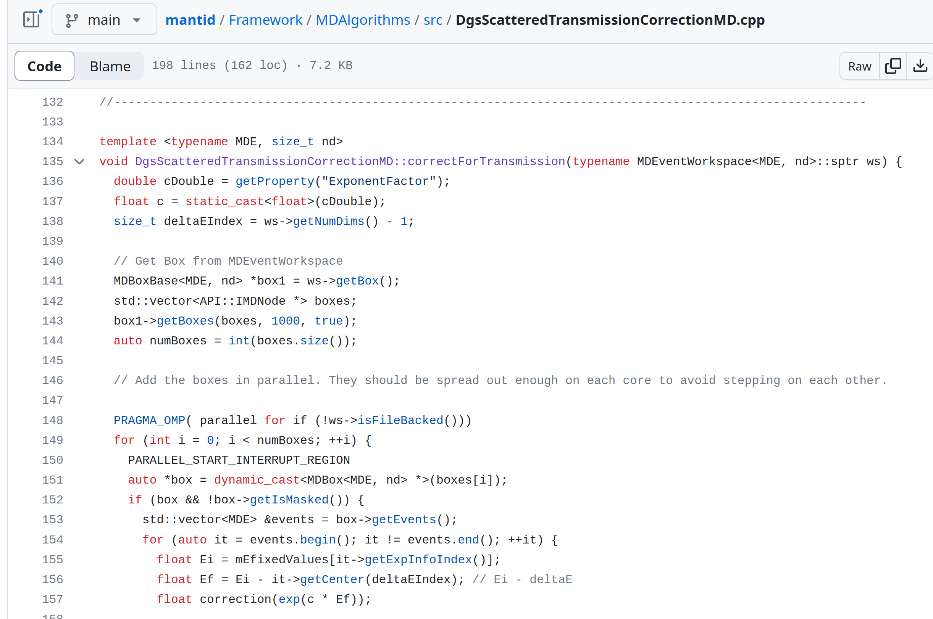
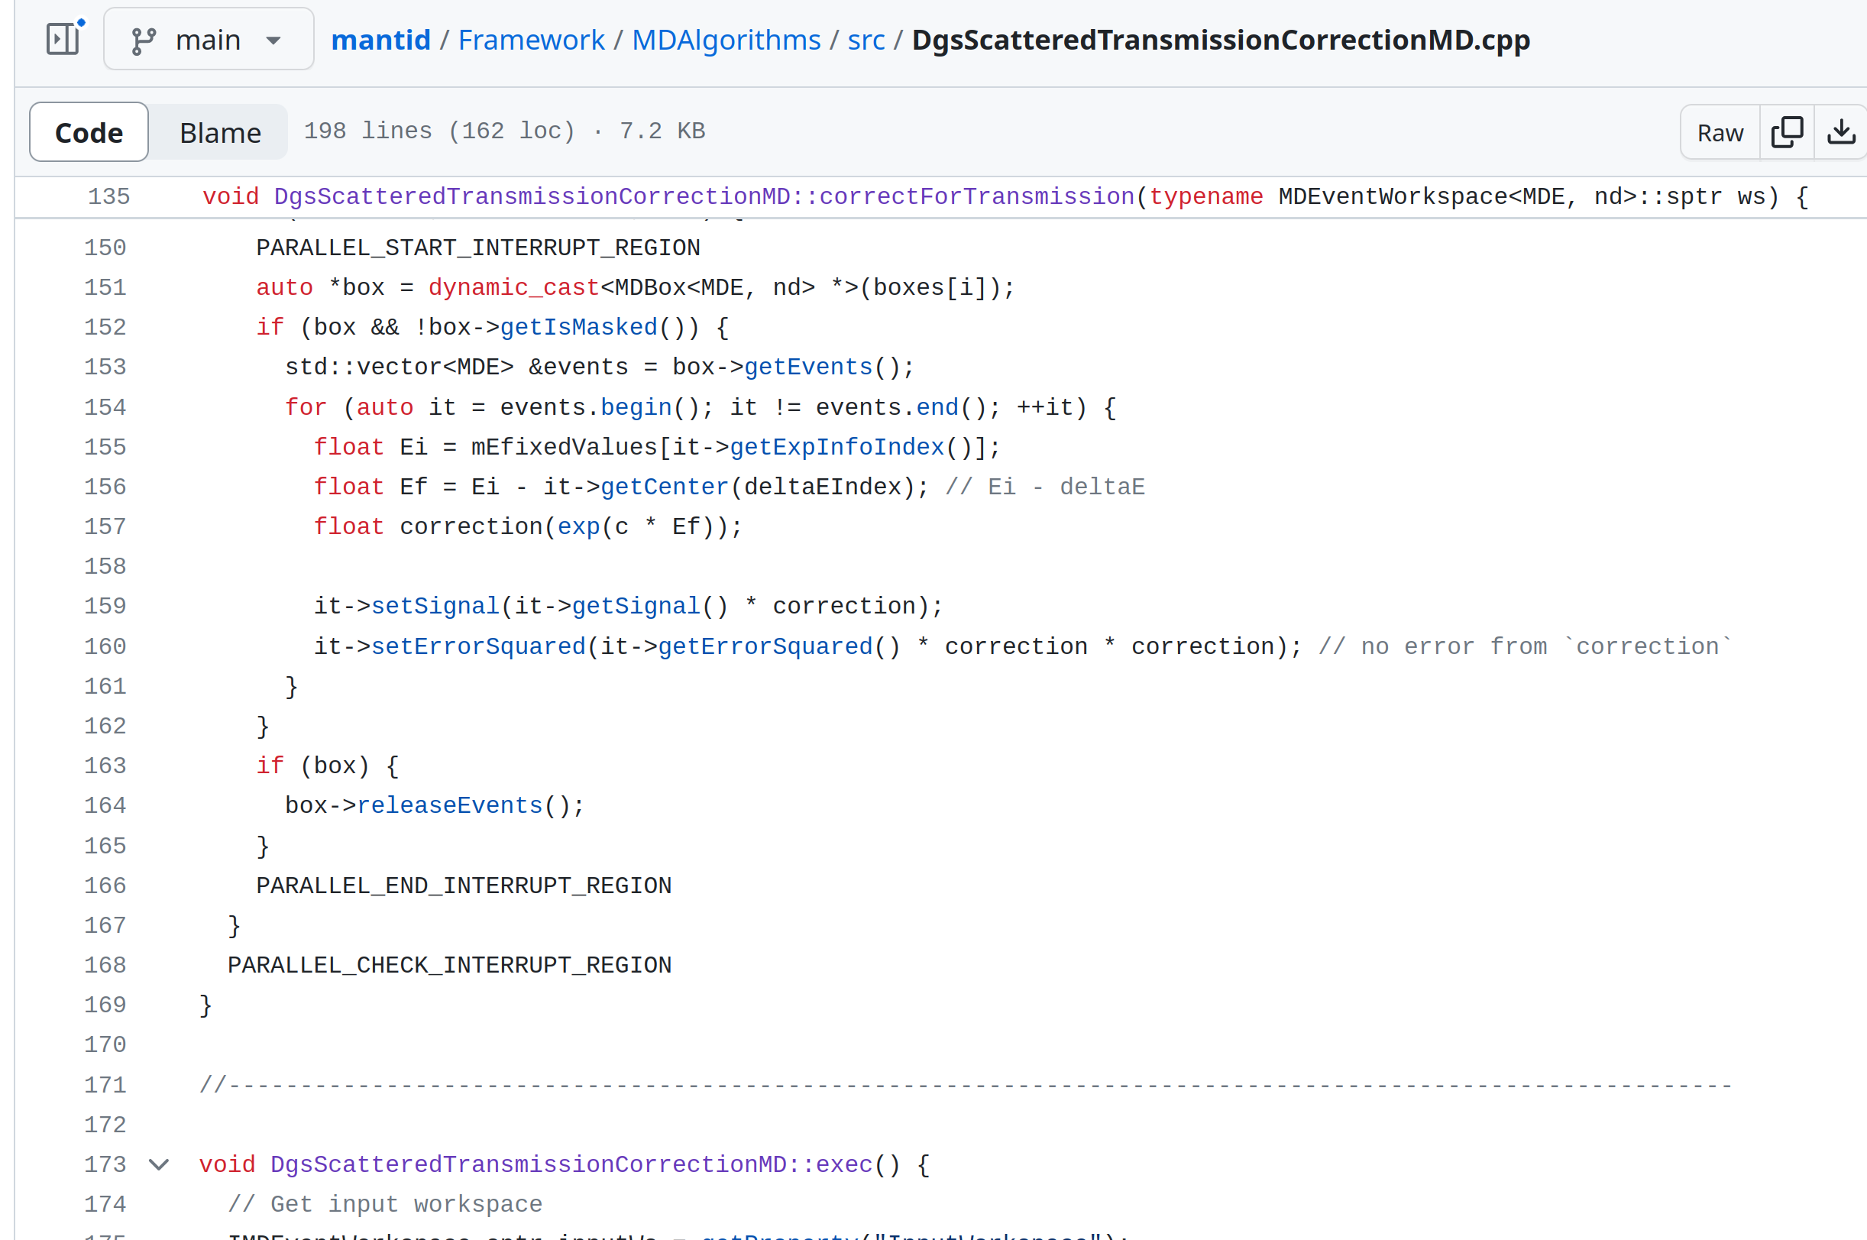
Worker function
Templated
Iterate over boxes
Iterate over events
Calculate factors
Set signal and error

